Slide 1
Image classification using CNN for Bags
Foundations of Machine Learning

Slide 2
Introduction
This project aims to develop an image classification model using Convolutional Neural Networks (CNN) to classify bags into three distinct categories: plastic, paper, and garbage bags.
This project explores the potential of CNNs in image recognition tasks and contributes to more efficient sorting and recycling of materials.

Slide 3

Dataset
This Dataset Contains Synthetic Images of Plastic, Paper, and Garbage Bags.
Total Images : 15,000 ( 5000 each class )
Subsets
2000 – Training 1000 – Validation 2000 - Testing

Slide 4
Exploratory Data Analysis

Slide 5
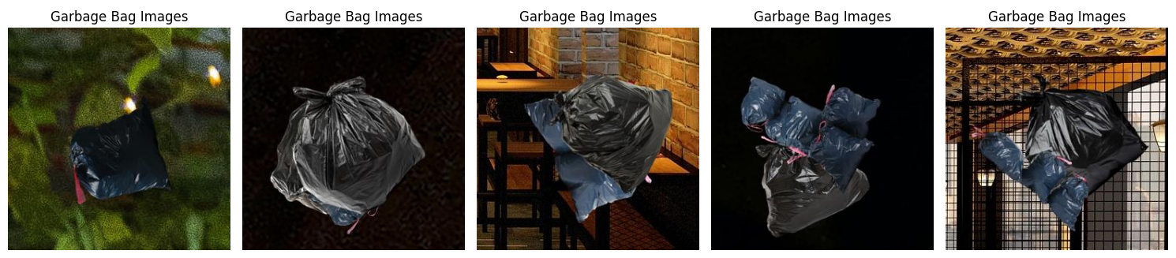
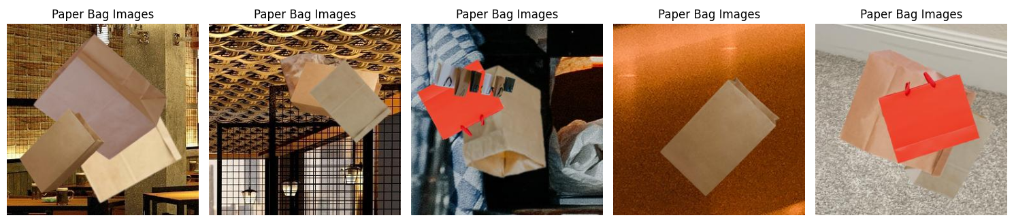
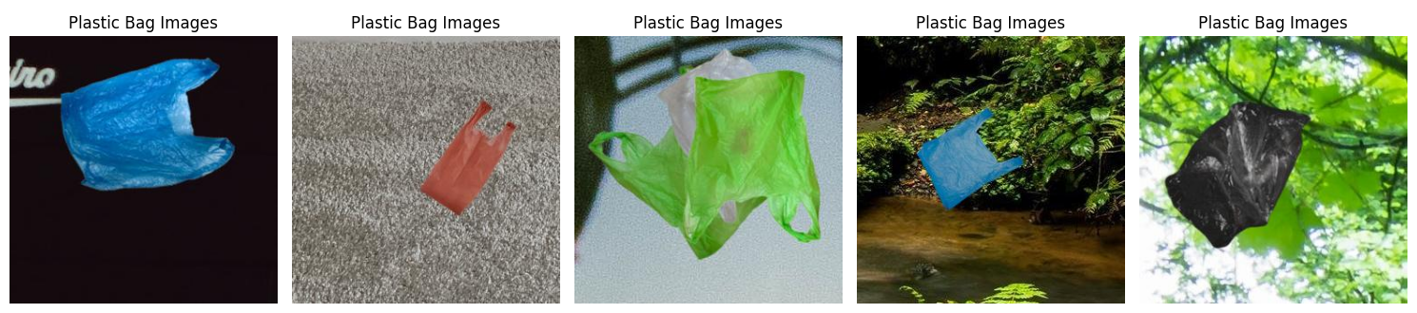

Slide 6
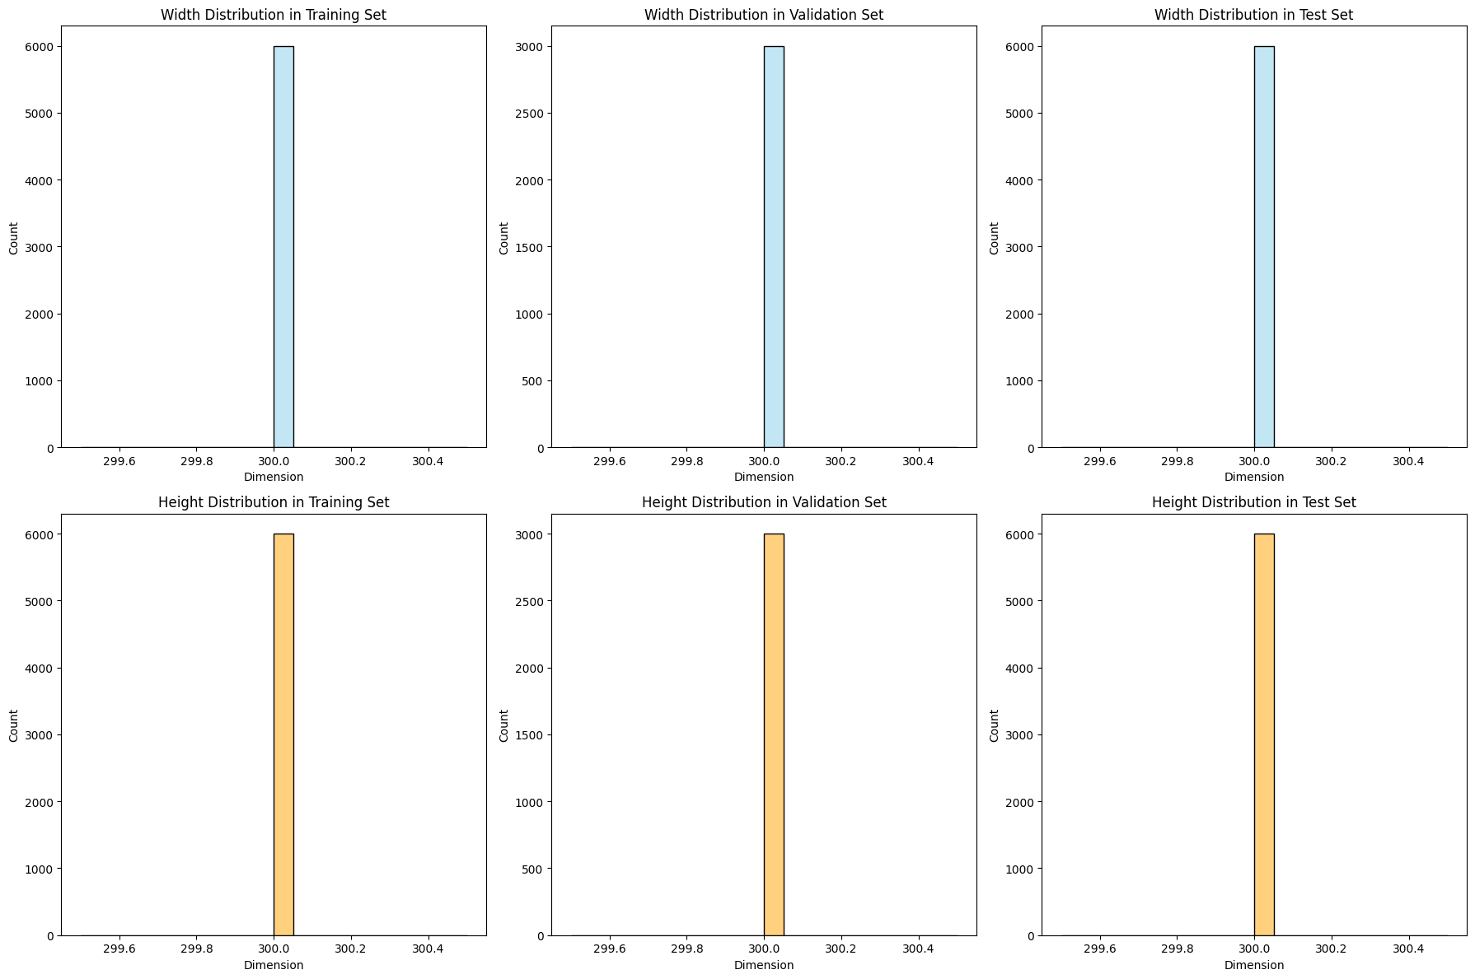
Image Size
Mimimum, Maximum and Mean image dimensions are 300 x 300. i.e all images in dataset are already in same dimensions.

Slide 7
Convolutional Neural Network (CNN)

Slide 8
CNN with 2 configurations
Defined CNN from scratch
1st Initial Approach
Followed common guidelines for the CNN training
Issue : training & validation error = 0
2nd Improved Approach
Enhanced previous model parameters
Optimized for higher accuracy

Slide 9
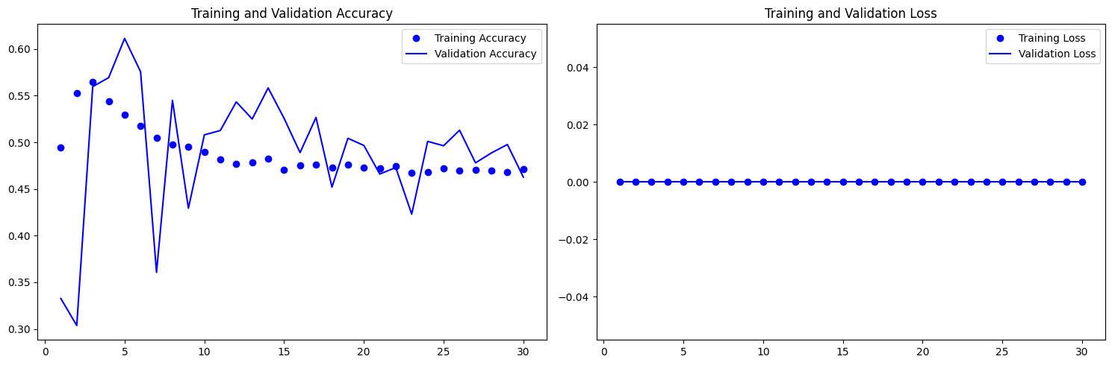
Outputs for 1st Approach

Slide 10
Model Definition
Activation : softmax
Optimizer : adam
Loss Function : sparse_categorical_corssentropy
Total Param : 1,130,947
1 input layer with Rescaling layer
5 Convolutional Layers
4 Max Pooling Layers & Batch Normalization Layers
1 Flatten Layer
1 Dropout Layer

Slide 11
Layer | Configurations | Purpose
Input Layer | Shape : (None,300,300,3) | 3 color channel of 300x300 px
Rescaling Layer | [0-255] Normalization of pixel values between [0-1] | To make neural network efficient & stable
1st Convolution layer 2nd Convolution layer 3rd Convolution layer 4th Convolution layer | 32 Neurons 64 Neurons 128 Neurons 256 Neurons | Kernal = 3 Activation = relu
Max Pooling Layer (4) | Pool size 2 Following to 1st 4 convolution layers | To reduce Spatial dimension
Batch Normalization (4) | Normalize previous layer output Following to Max pooling layers | Normalize output from Maxpool Accelerate convergence ( smoothen effect )
5th Convolution layer | 256 Neurons | Kernal = 3 Activation = relu
Flatten Layer |  | Convert multi-dimensional output into single vector
Dropout Layer |  | Prevent overfitting

Slide 12
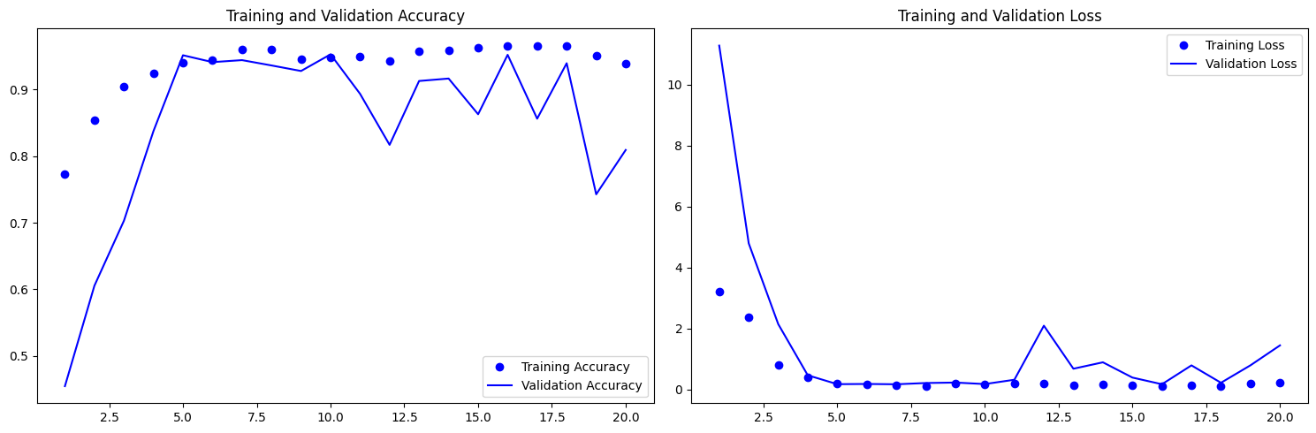
Accuracy

Slide 13
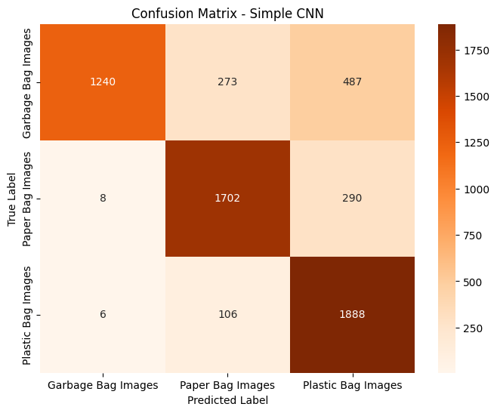
Confusion Matrix

Slide 14
Thank You

